Slide 1

CPU Scheduler Simulator
Viraj Sheth, Josh Ginnett, Alex Xhemo, Zach Santiana

Slide 2
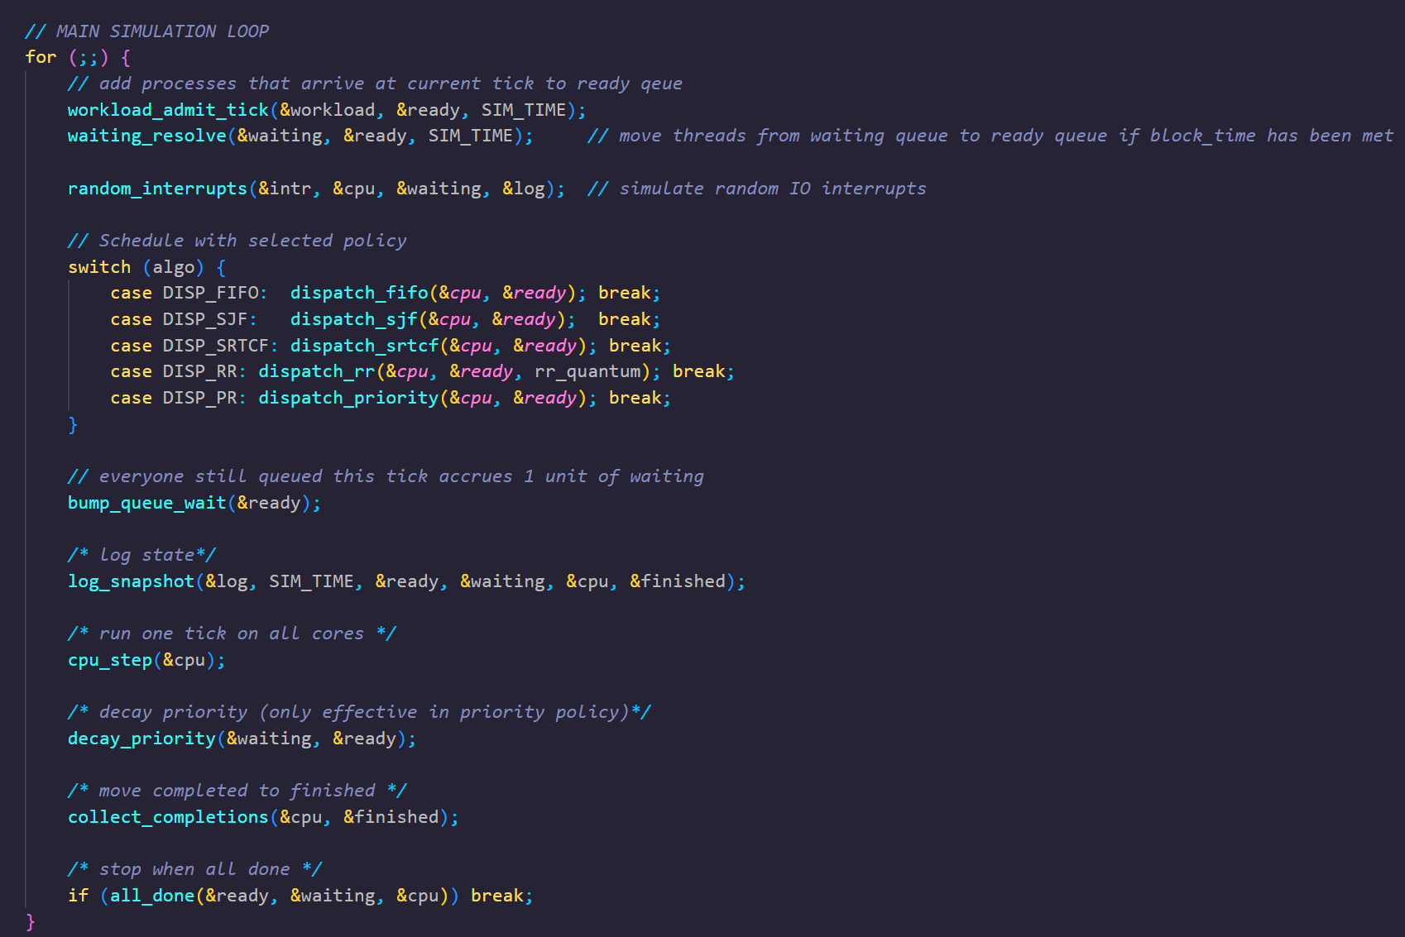
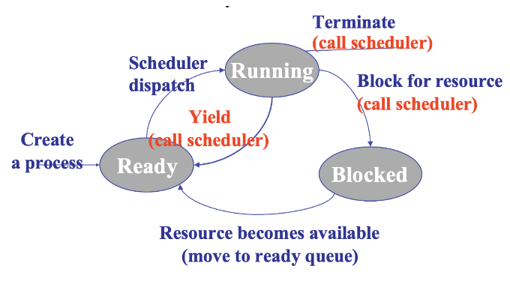
Scheduling Diagram

Slide 3
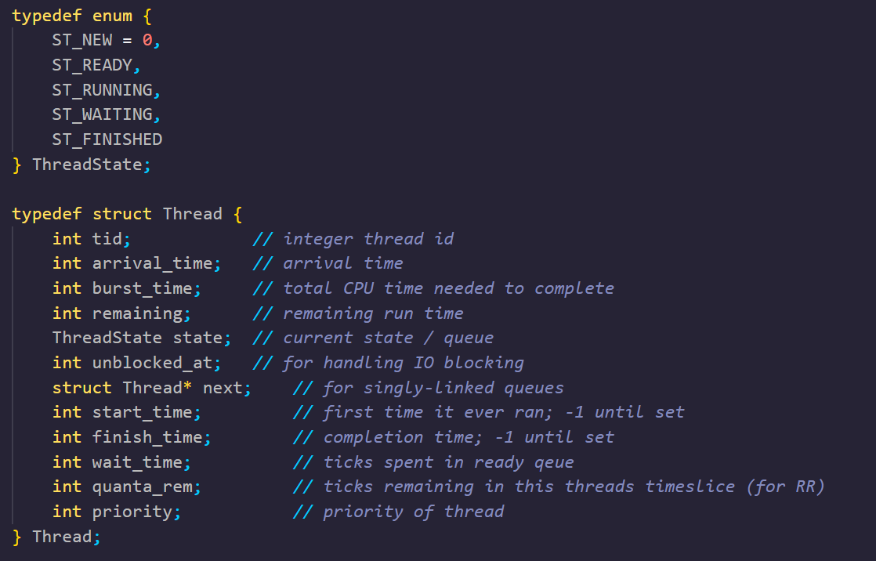
Defining the Structure for Jobs
Enumerations for state type
Similar to a PCB:
  tid: keep track of process ID
  Arrival/burst time for scheduler
    RR also defines time slice with quanta_rem
    Priority scheduler also defines priority of job
  state: job state
  Start/finish/wait times for statistics
From sim.h

Slide 4
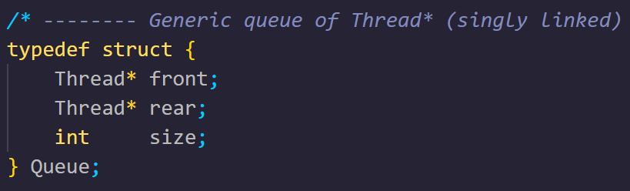
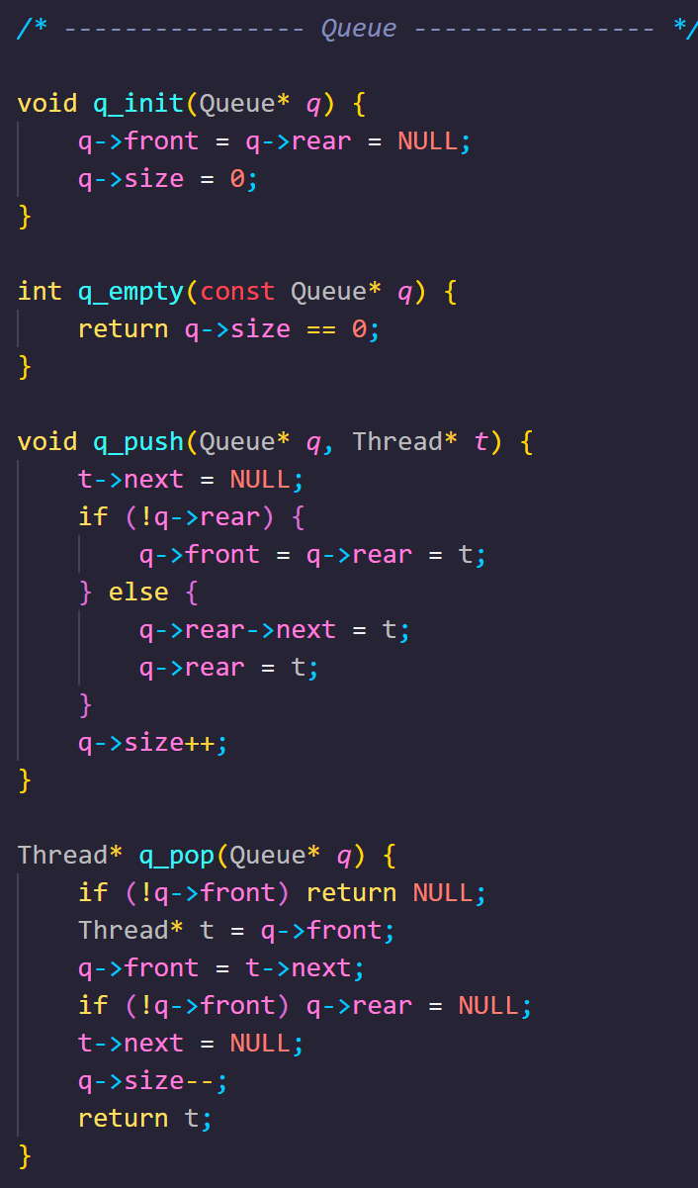
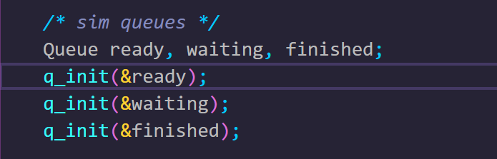
Queue Structures
Keep track of proper job order with 3 running queues
  Ready, Waiting, Finished
Generic queue implementation
  Scheduler will interact with queues to order processes
  Initialize in sim.c
Chosen algorithm will run on processor simulation
  Processes flow through queues with help from cpu.c and dispatch.c
From sim.h
From util.c

Slide 5
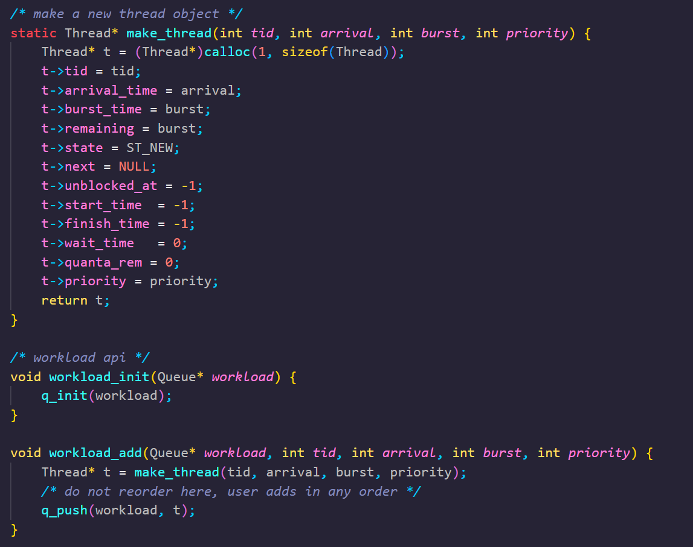
Create a Process
workload_add() → add job
make_thread() creates a new structure of type Thread
All new Threads pushed into workload queue
  NEW state → not READY yet
From sim.c

Slide 6
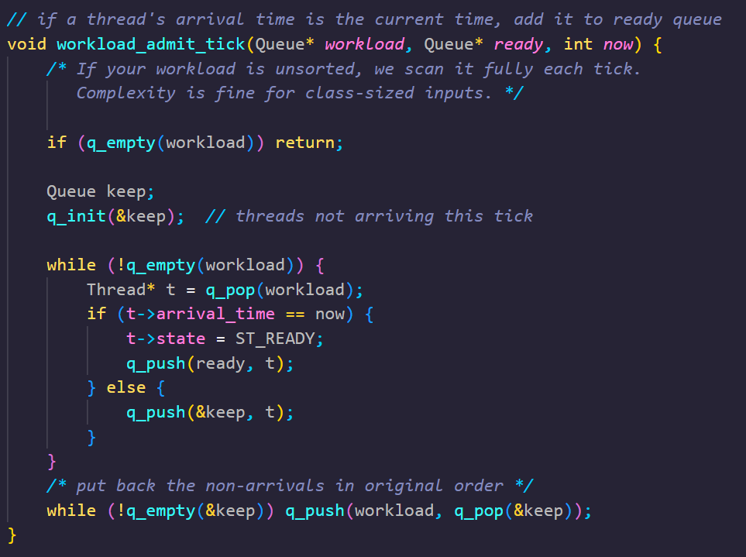
Move Jobs to READY
At each tick now, check the workload queue
Threads whose arrival_time == now move from NEW → READY
Simulates thread spawning for scheduler to handle.
Others stay in the workload queue
  Use queue keep to preserve order
From sim.c
Notes:
Job is created, then admitted into the ready queue when its arrival time comes

Slide 7
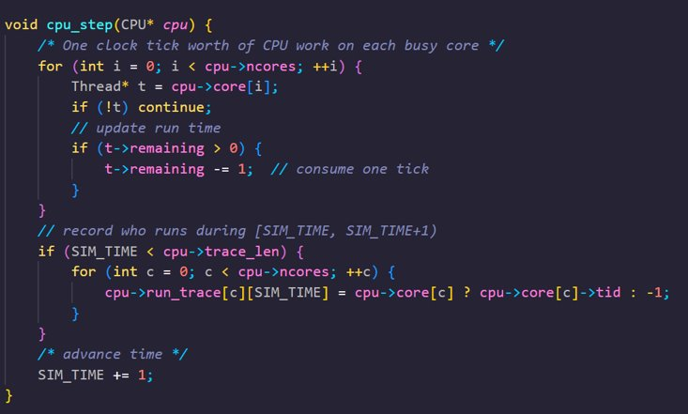
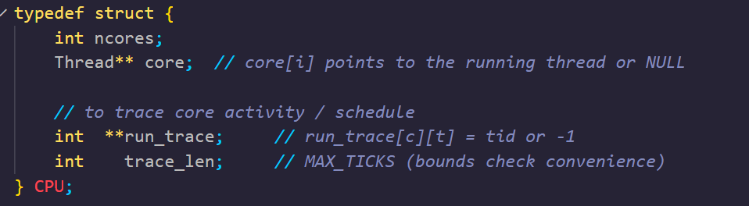
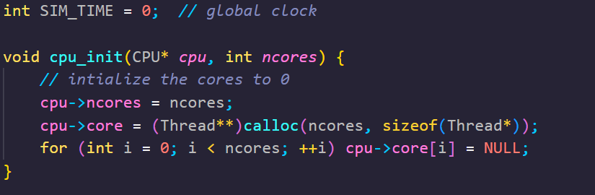
CPU Structure with Multiple Cores
Schedulers can bind threads to cores with cpu_bind().
Steps through process as jobs are scheduled and consumes process runtime to simulate execution
cpu_step() called once per clock tick.
From sim.h: CPU structure passed to simulator
From cpu.c Initialize CPU with n cores, allocate thread space

Slide 8
RUNNING
Simulate a tick
For each tick:
  Decrement remaining burst time for thread
  For RR only: decrement remaining time quantum.
  Record which tid is running per core in run_trace (logging purposes)
  Increment global SIM_TIME (clock cycle)
From cpu.c

Slide 9
Dispatcher: Scheduling Policies
Non-Preemptive
Preemptive
FIFO
SJF
SRTCF
Round Robin (RR)
Priority Scheduler
User can choose scheduling policy

Slide 10
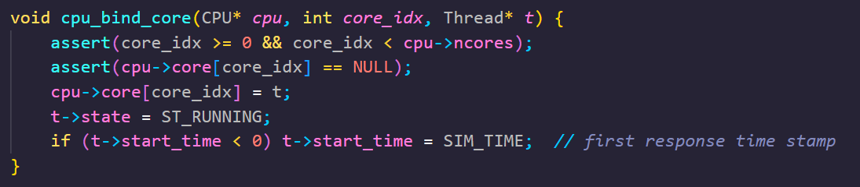
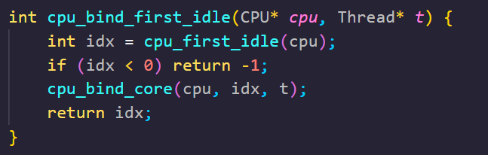
READY to RUNNING
Dispatcher pops from READY, binds thread to an idle core
Set to running state
start_time set the first time the thread runs
  For calculating response time
From cpu.c

Slide 11
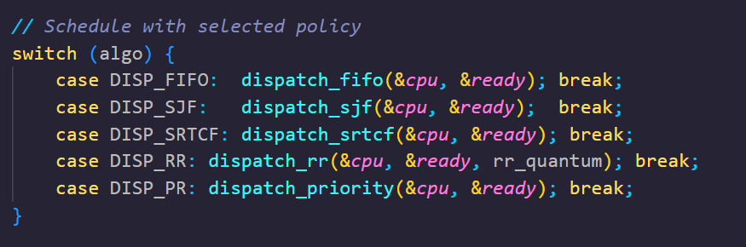
READY to RUNNING Continued
Insert screenshot of "scheduled with selected priority block" in main simulation loop of sim.c
In main simulation loop, threads are dispatched according to the selected dispatch policy.
From sim.c

Slide 12
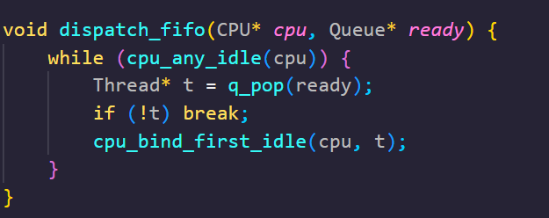
Dispatch Handler: FIFO Policy
First In First Out
  Pass ready queue and CPU cores
  While cores available for scheduling:
    Pop from ready queue
    If t returns NULL, empty queue, break
    Else, bind to CPU core to process job
  In order scheduling as jobs arrive to queue
From dispatch.c

Slide 13
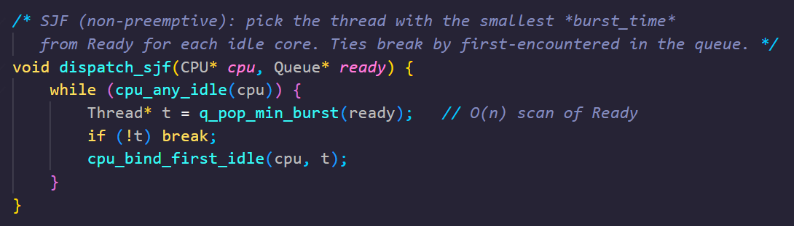
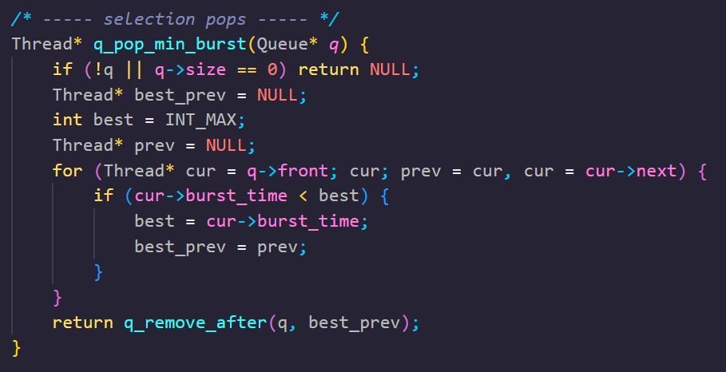
Dispatch Handler: SJF Policy
Shortest Job First
  Pass ready queue and CPU struct
  While cores available:
    Pop shortest length job with q_min_burst
      Returns shortest burst time (O(n))
      Uses q_remove_after() to remove from middle
    If t returns NULL, empty queue, break
    Else, bind to CPU core to process job
From dispatch.c

Slide 14
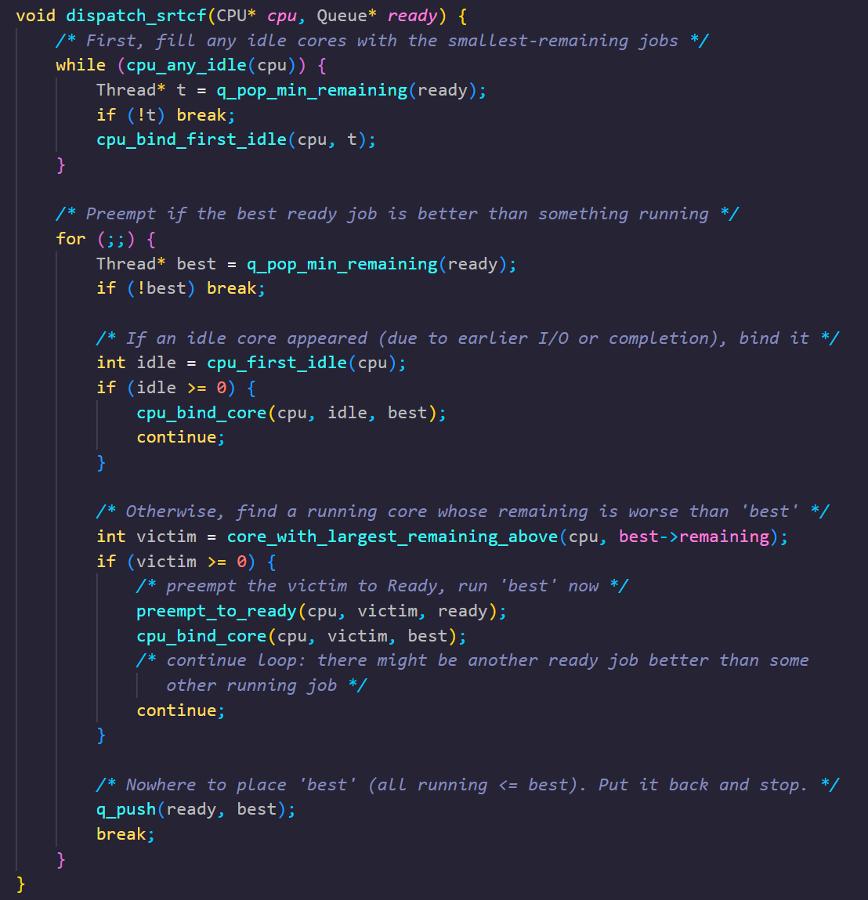
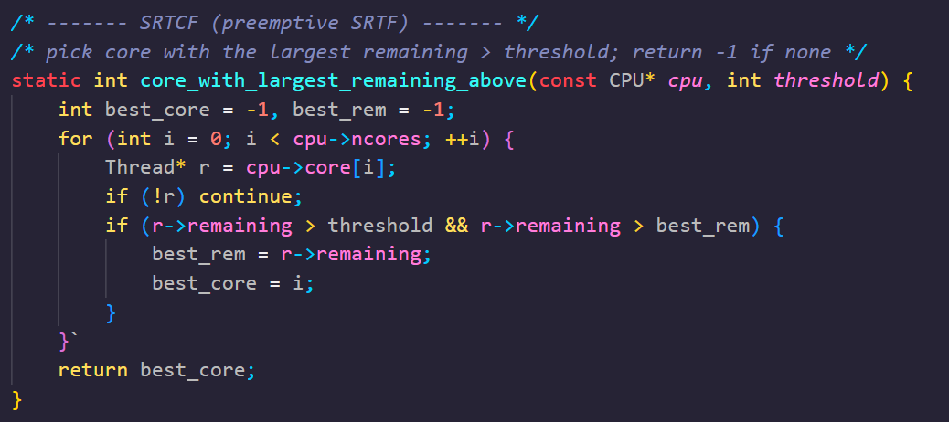
Dispatch Handler: SRTCF Policy
Shortest Run to Completion First
  Preemptive version of SJF
  First fill idle cores with shortest remaining jobs
    Look for "victim" core whose job has more remaining time
    If a shorter job arrives, can preempt longer one
Place job back in queue if current jobs are equal/better
From dispatch.c

Slide 15
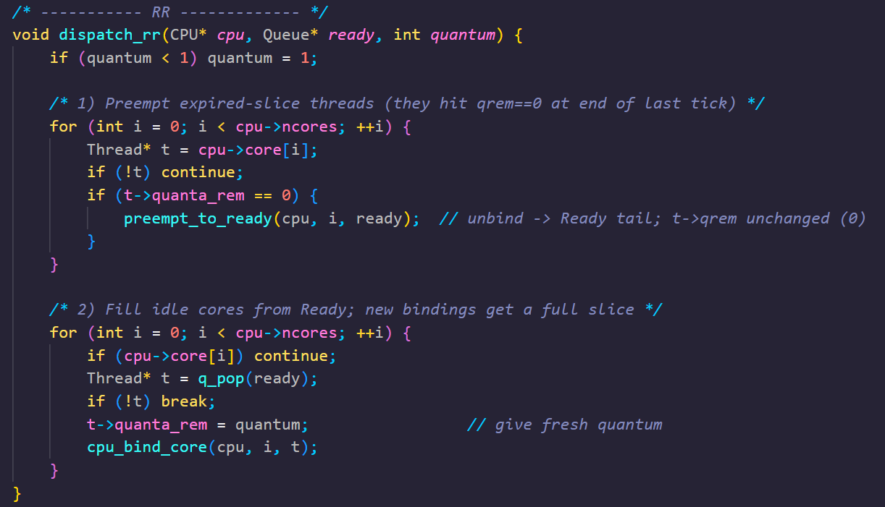
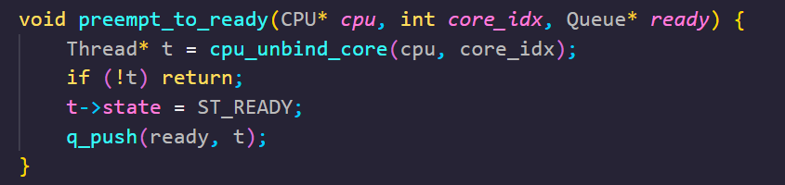
Dispatch Handler: RR Policy
Round Robin
  Pass ready queue, CPU struct, and quantum int
    Quantum int dictates time scheduled on CPU
  Set process run time with quantum
  1) Iterate over all
    Check for jobs with expired quantum
      If expired, unbind job from core with preempt_to_ready()
      move to ready queue if not NULL
  2) Iterate over all CPU cores
    Break if no jobs available
    Else, reset remaining quantum time and bind to CPU core
From dispatch.c

Slide 16
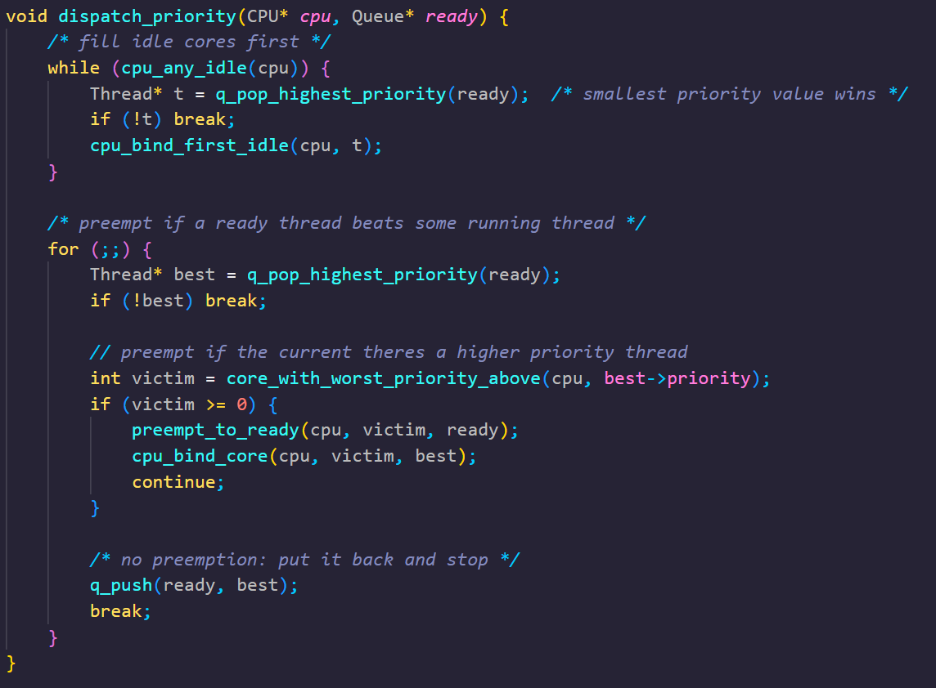
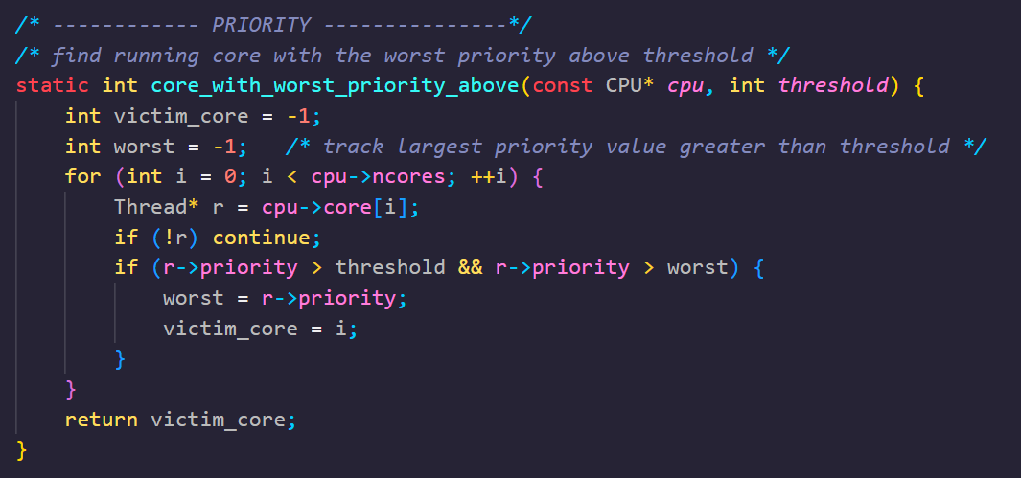
Dispatch Handler: Priority Policy
From dispatch.c
While cores idle
  Pop highest priority job from ready queue
  Bind to core til empty queue
If there are other ready threads, check for priority
  Find lowest priority victim
  Move to ready queue off core
  Replace with higher priority job

Slide 17
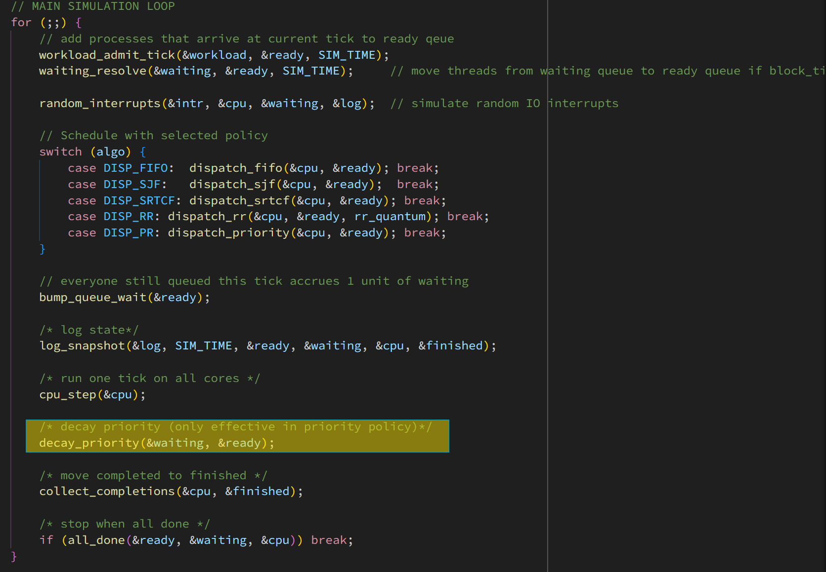
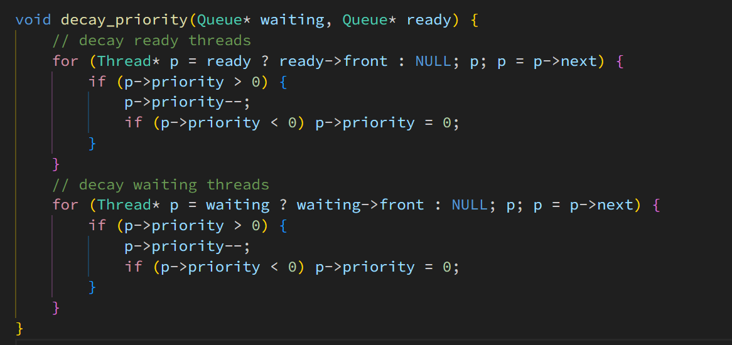
Dispatch Handler: Priority Policy Cont.
Decay priority for waiting and ready threads each clock cycle.
  Process's spawn with random or user defined priority before simulation.
Decay in main simulation loop:
Decay handler in util.c:

Slide 18
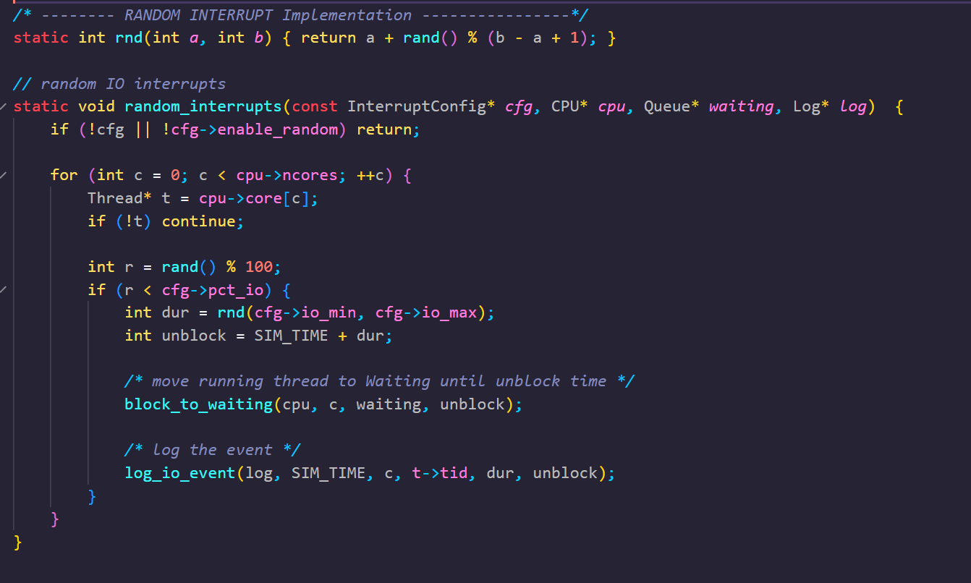
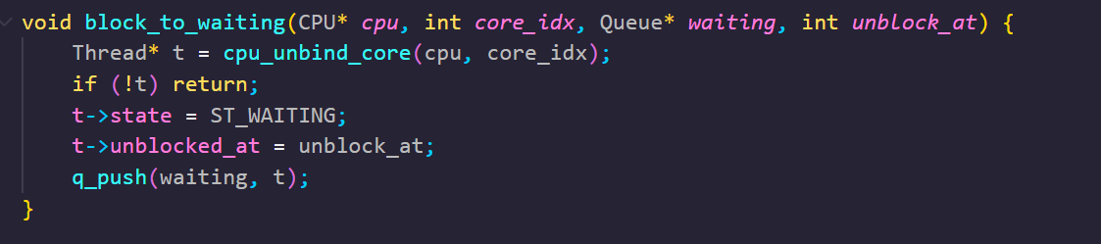
WAITING (BLOCKED)
Random IO interrupts simulated in sim.c
  Update every tick to add unique IO blocks
Process gets blocked and moved to waiting queue to allow IO to execute
  Removed from CPU and requires rescheduling
Runs uniquely each time according to rng seed
From sim.c (top), cpu.c (bottom)

Slide 19
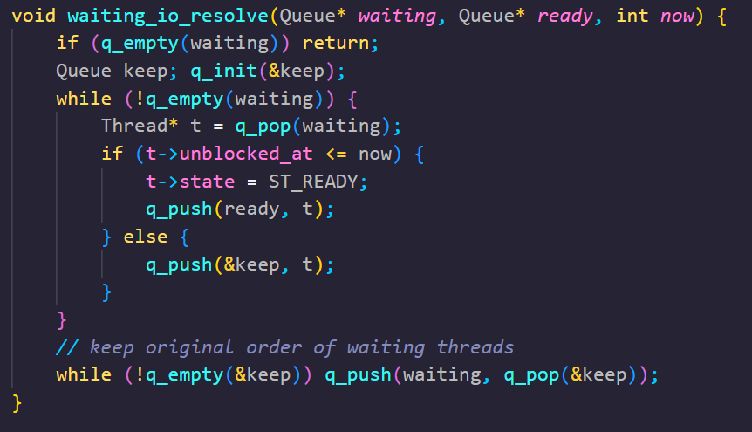
Resolve WAITING
Called every tick to check for unblock
  Resolve before new interrupt call
Move processes from wait queue to ready queue
This structure allows us to accurately simulate interrupts in the system and model real world complexity to our scheduler
From util.c

Slide 20
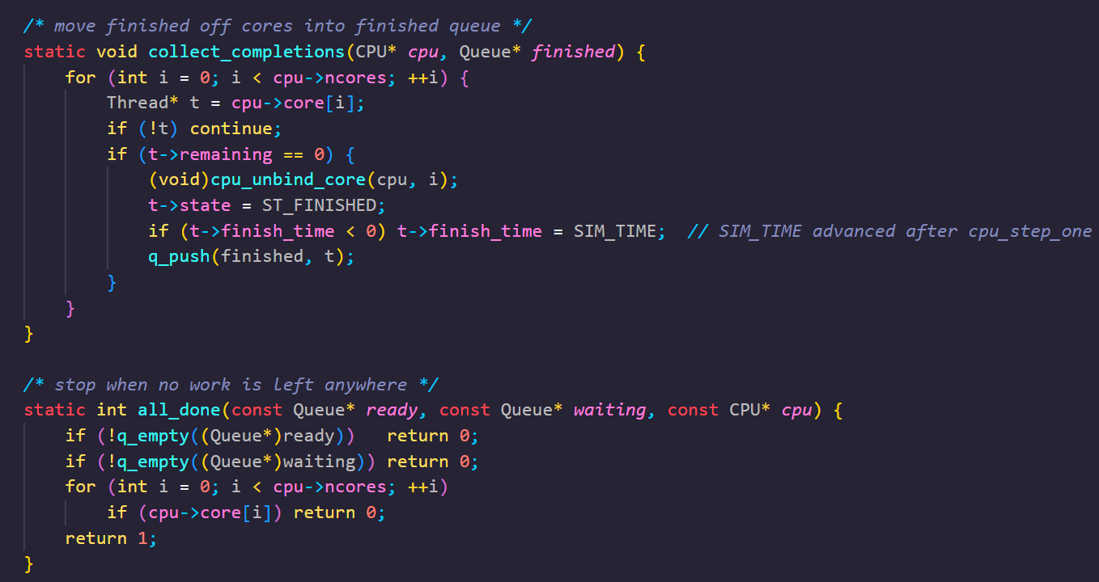
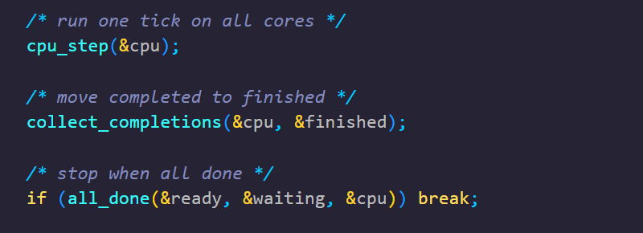
Complete Jobs
Collect_completions used to remove jobs from core to finished queue
  Handle unbinding and state tracking
All_done checks for any waiting or ready processes leftover in data structs
In main, call to collect finished jobs and check for end of job queue
From sim.c

Slide 21
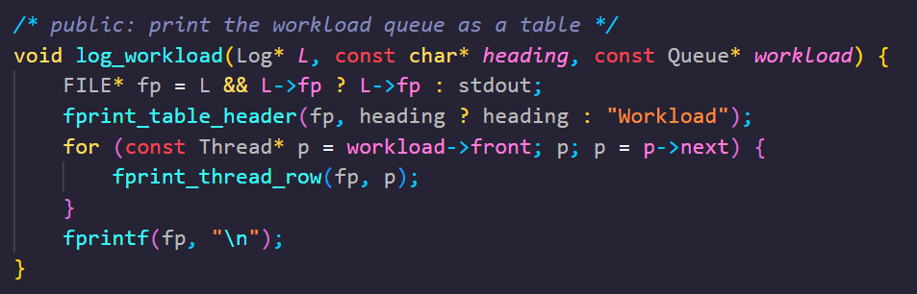
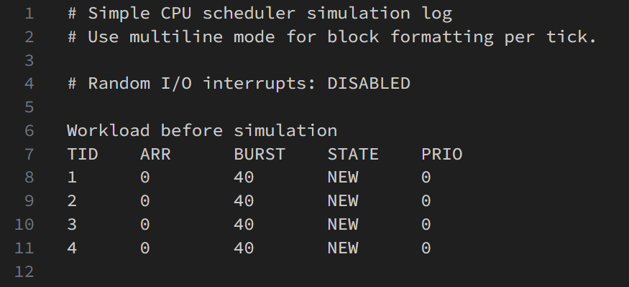
Statistics and Logging
At the start of each simulation, log the generated or user entered workload and store in sim_log.txt
From util.c

Slide 22
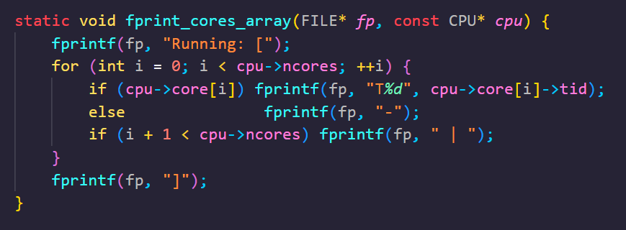
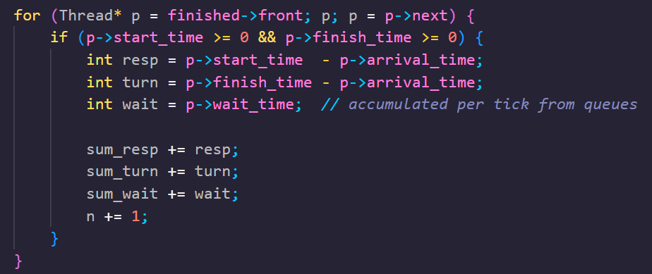
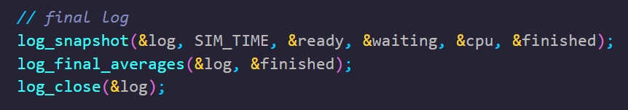
Statistics and Logging Continued
Iterate over finished queue and compute response time, turnaround time, and wait time by reading respective Thread object members.
Print results to sim_log.txt to view queues at each tick, and statistics.
Print trace of what thread is running on each core to core_trace.txt
Python script reads core_trace.txt:
  Visualize running queue with matplotlib
From sim.c

Slide 23
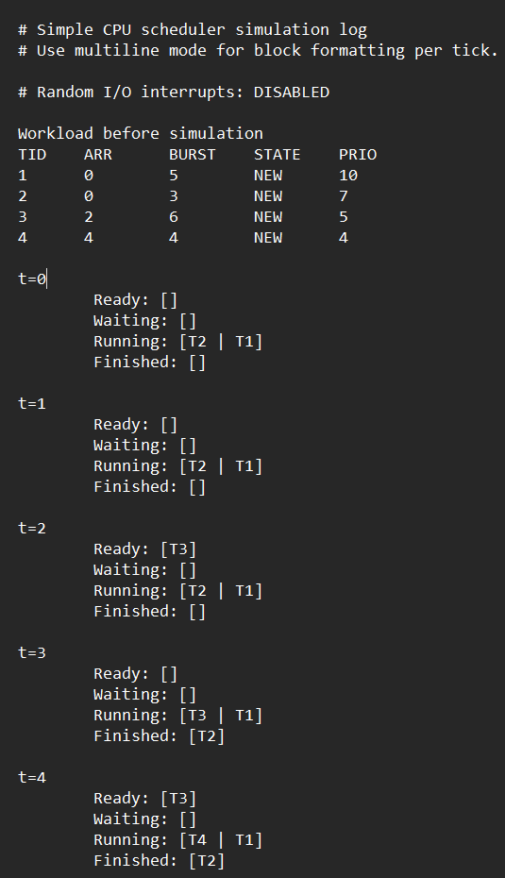
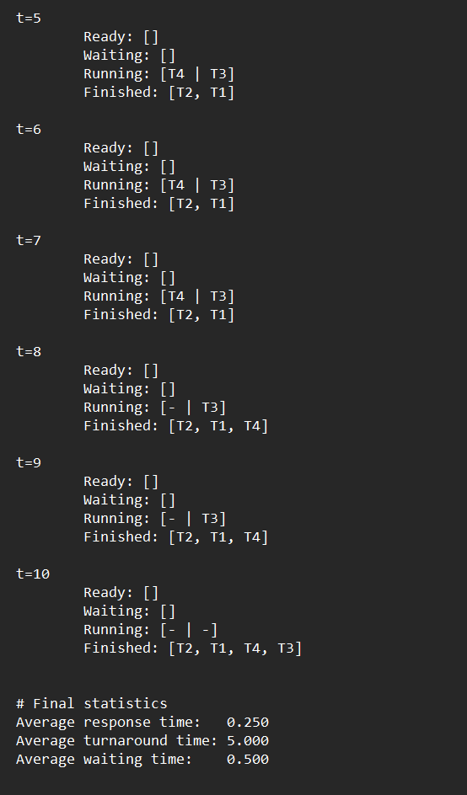
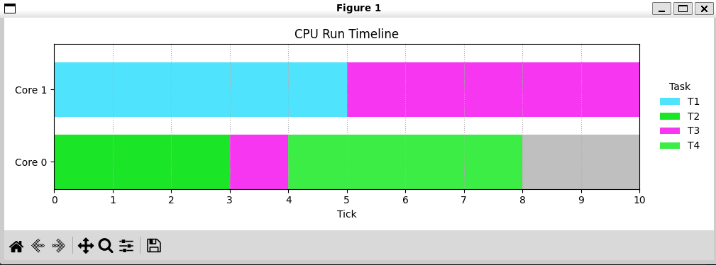
Output Log and Timeline Example
Output plot
Small preset workload example
  2 cores, 4 tasks
  Gray space = idle
From sim_log.txt

Slide 24
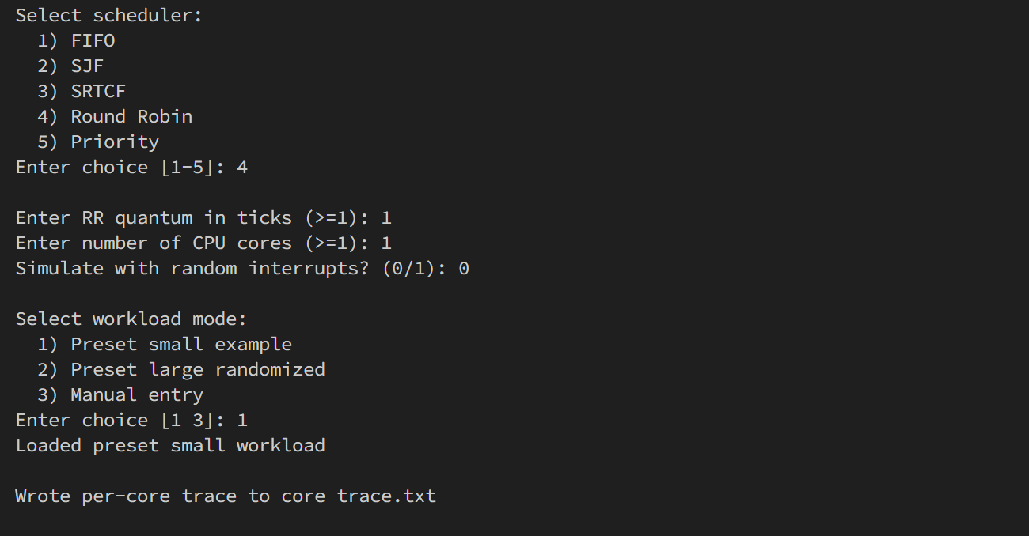
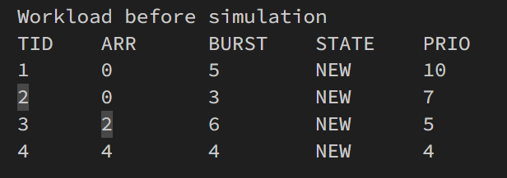
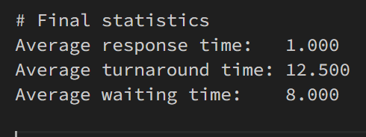
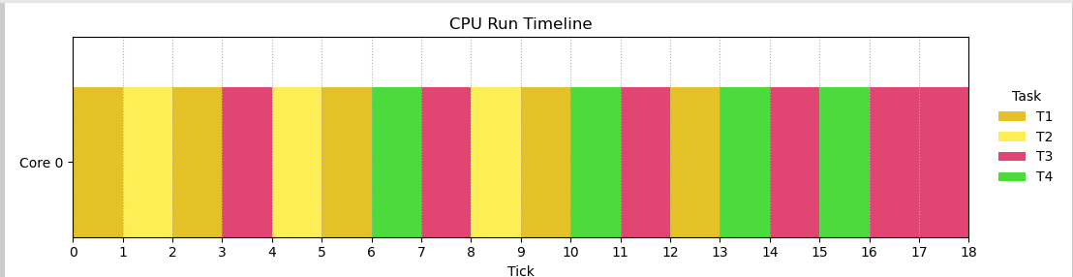
Simulating with RR Dispatch Example:
User Interface (CLI):
sim_log.txt:
core_trace.txt and python visualization:

